Slide 1




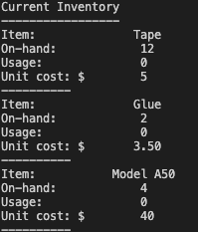

Inventory Management Application by Max Folger Placing the power of your inventory at your fingertips
z
Increase sales, customer satisfaction, and efficiency through effective inventory management.
Features
Total inventory overview
Add new items and their cost/quantity
Track usage
View critical inventory reports
View the program at https://github.com/ksu-is/inventory-management-program-1

